Slide 1
EEE 2113 Electrical Circuits Basic Concepts Section 1.1, 1.2, 1.3, 1.4, 1.5, 1.6 from Fundamentals of Electric Circuits (5th Edition) by Alexandar and Sadiku
Md. Shafqat Talukder Rakin
Lecturer, Department of CSE,
United International University
Email id : shafqat@cse.uiu.ac.bd
Courtesy: Rifat Bin Rashid

Slide 2
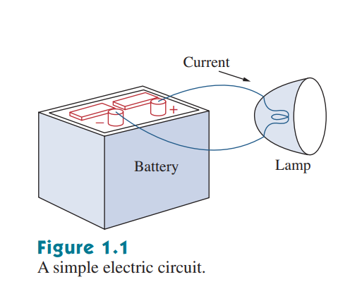
Electric Circuit
An electric circuit is an interconnection of electrical elements

Slide 3
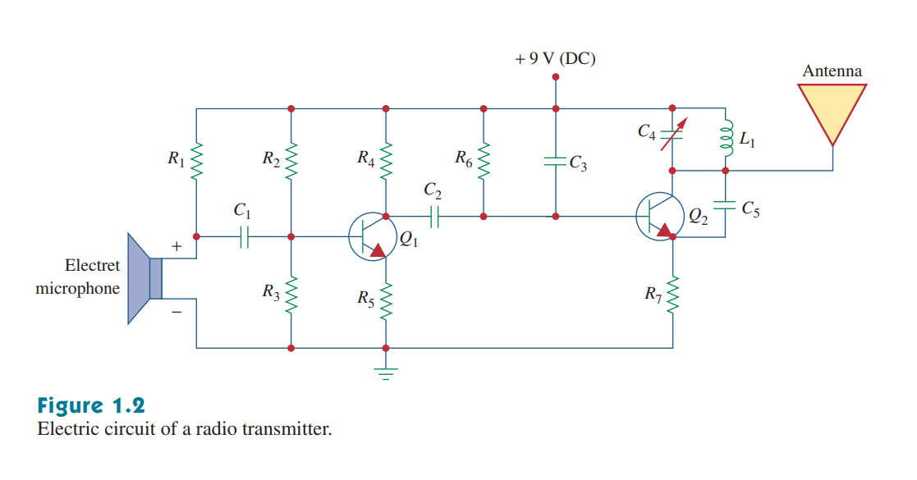
Electrical Circuit
A real-life electrical circuit consists of various components

Slide 4
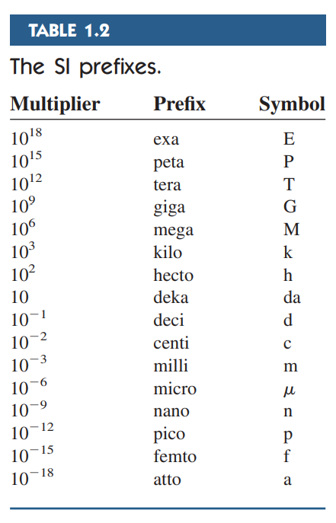
System of Units

Slide 5

Electrical Charge
Charge is an electrical property of the atomic particles of which matter consists, measured in coulombs (C).
Atoms are made up of protons, electrons and neutrons
A neutral atom has equal number of protons and electrons
A positively charged atom has less electrons than protons
A negatively charged atom has more electrons than protons
A single electron has a charge of 1.6 x 10⁻¹⁹ C

Slide 6
Electrical Charge
The coulomb is a large unit for charges. In 1 C of charge, there are 6.24 x 10¹⁸ electrons. Thus, realistic or laboratory values of charges are on the order of pC, nC.
The law of conservation of charge states that charge can neither be created nor destroyed, only transferred. Thus, the algebraic sum of the electric charges in a system does not change

Slide 7
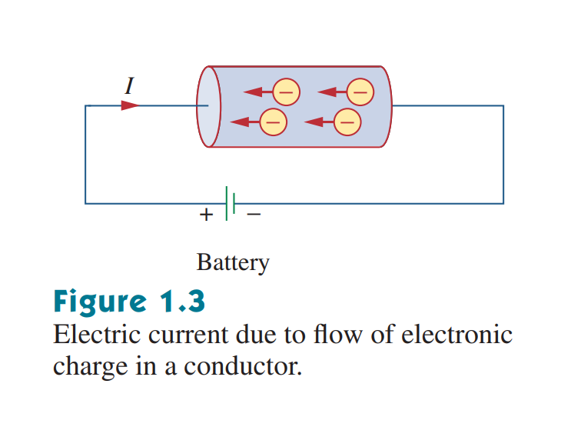
Flow of Charges
In electrical circuits, we are concerned with the charges that can freely move or flow
When we apply an electromotive force (emf) on charges, they gain energy, and start moving
Emf is also known as voltage or potential difference
Notes:
Direction of flow of current vs flow of electrons is opposite. We follow conventional direction of current.

Slide 8
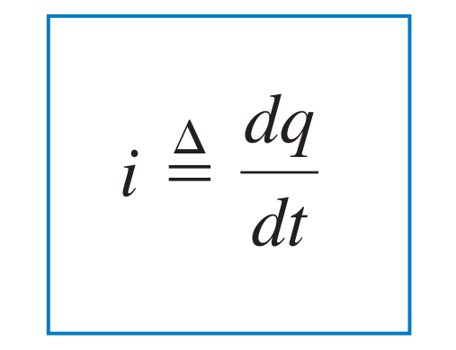
Electric Current
Electric current is the time rate of change of charge, measured in amperes (A).
Mathematically, the relationship between current i, charge q, and time t is
where current is measured in amperes (A), and 1 A = 1C/s

Slide 9
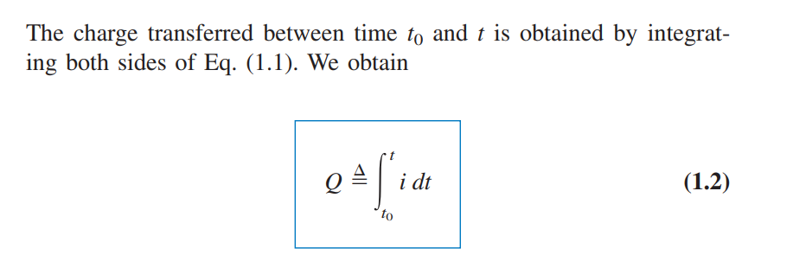
Quantifying Electrical Charge
Notes:
Charge and current not constant and can change with time. The classic physics formula we studied comes if we consider current to be constant.

Slide 10
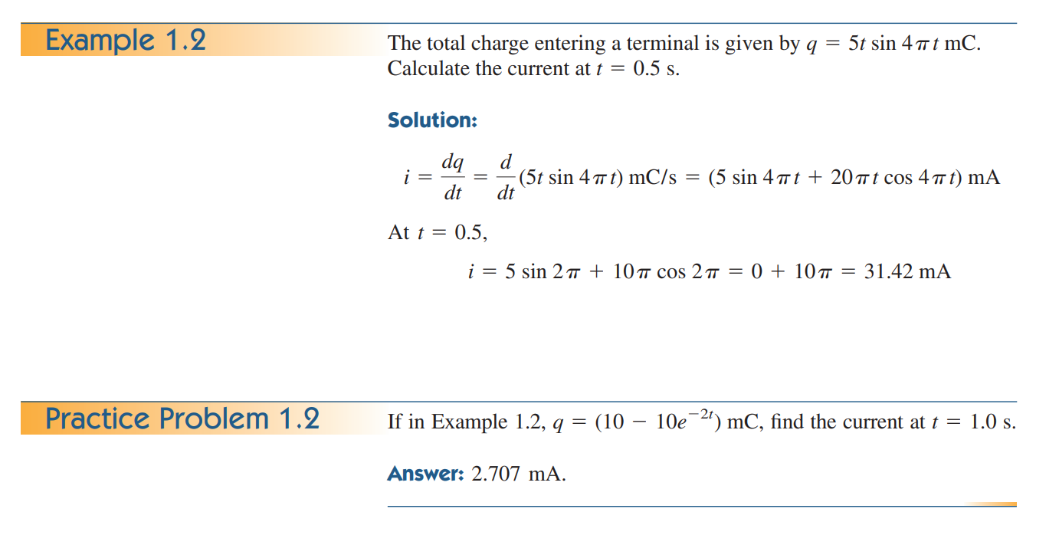

Slide 11
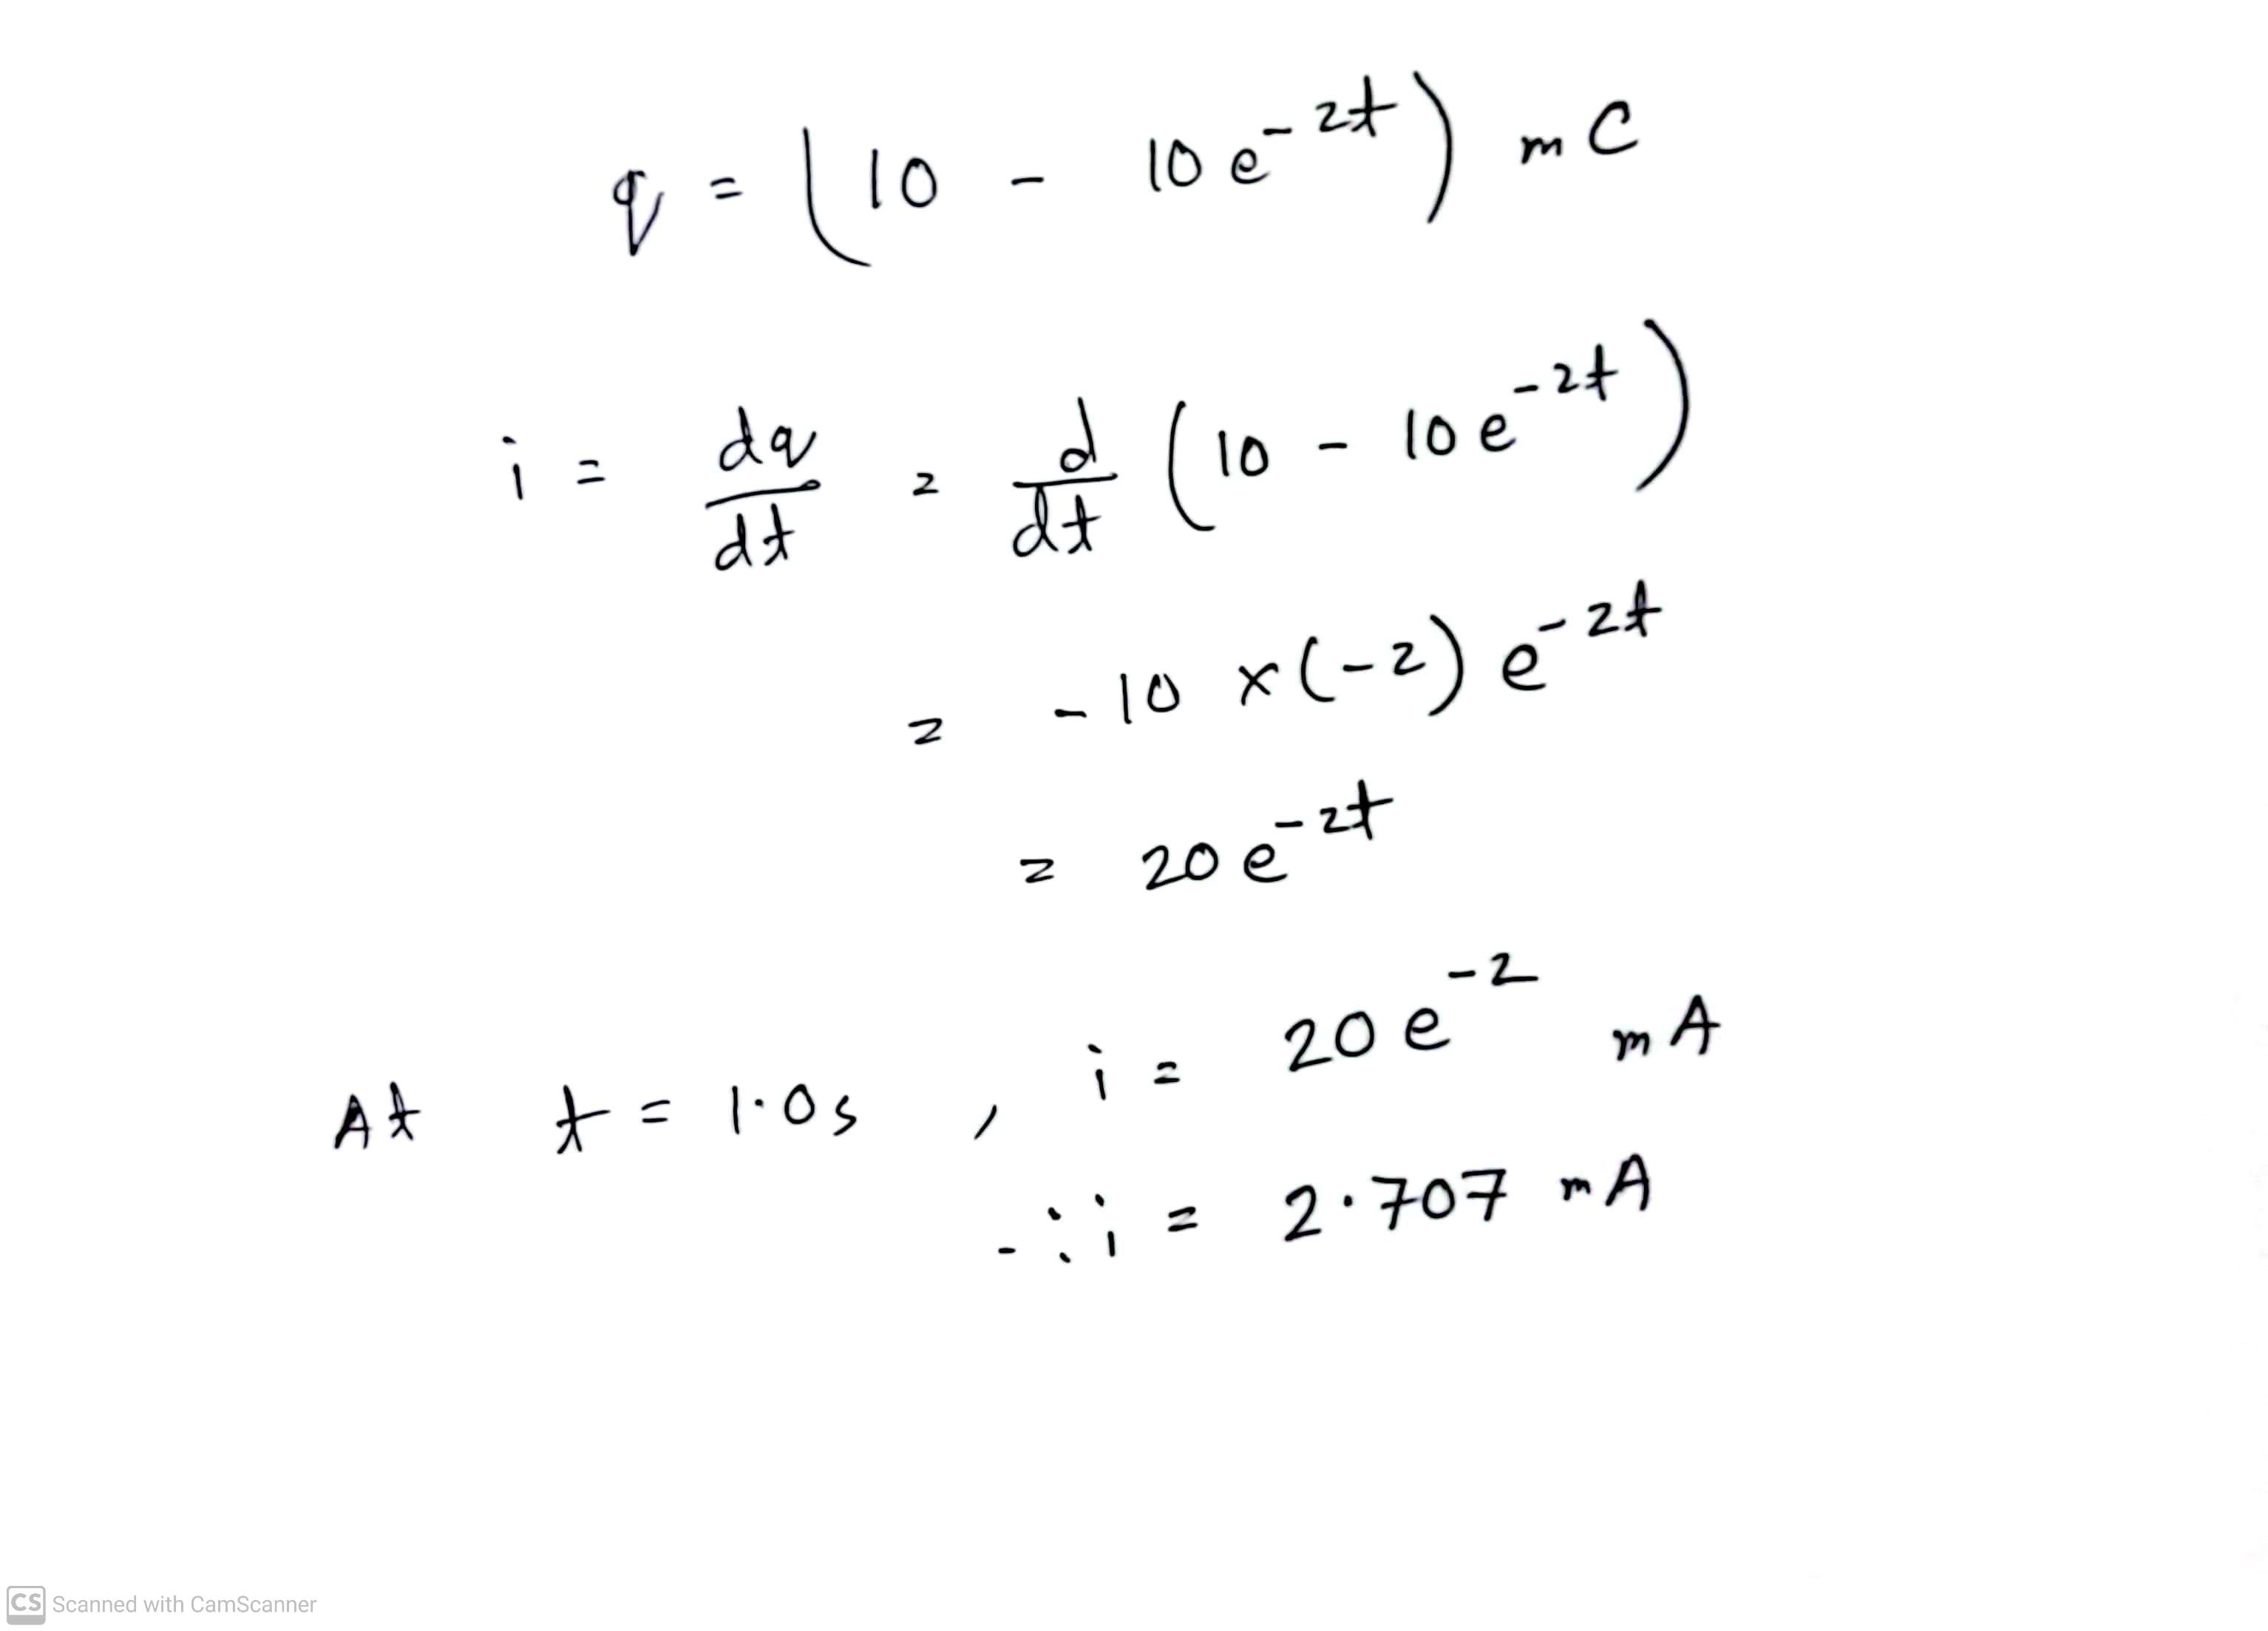
Practice problem 1.2 (Solve)

Slide 12
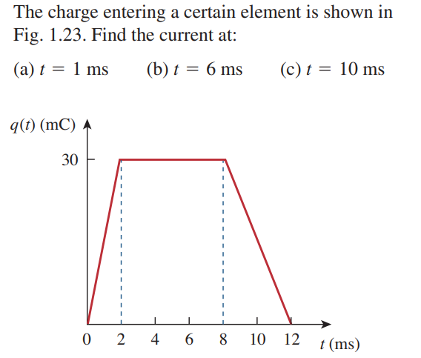
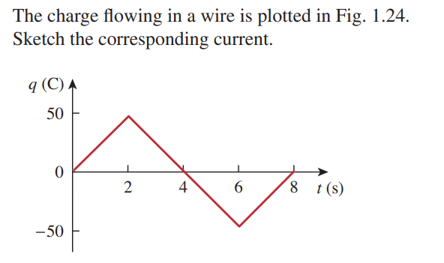
Math Problem Practice:

Slide 13
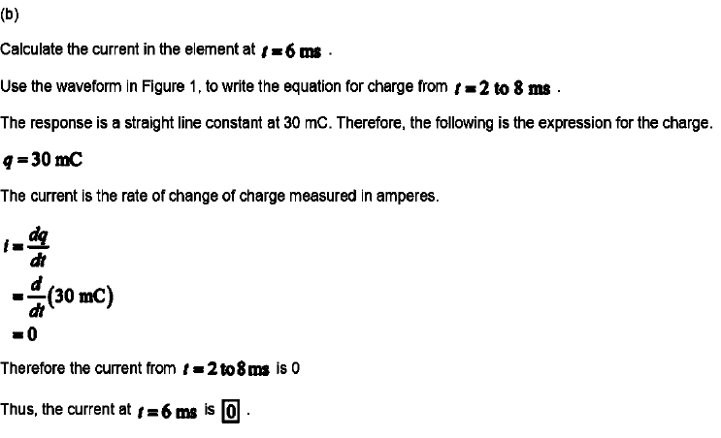
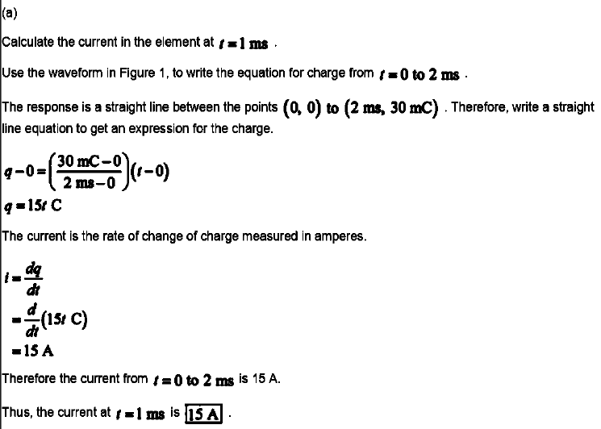
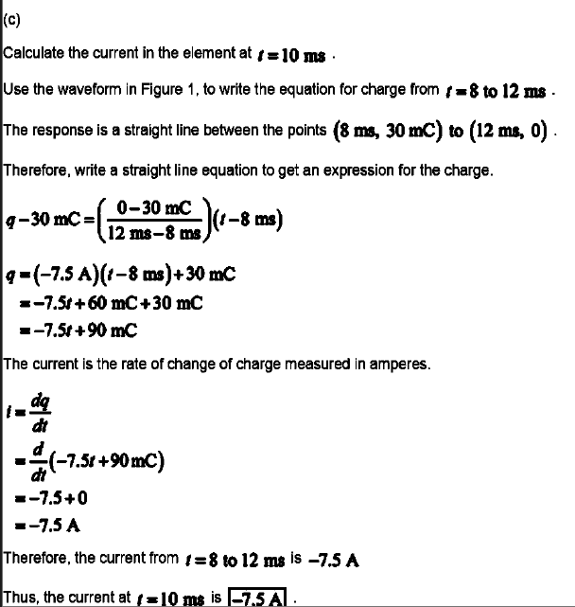

Slide 14
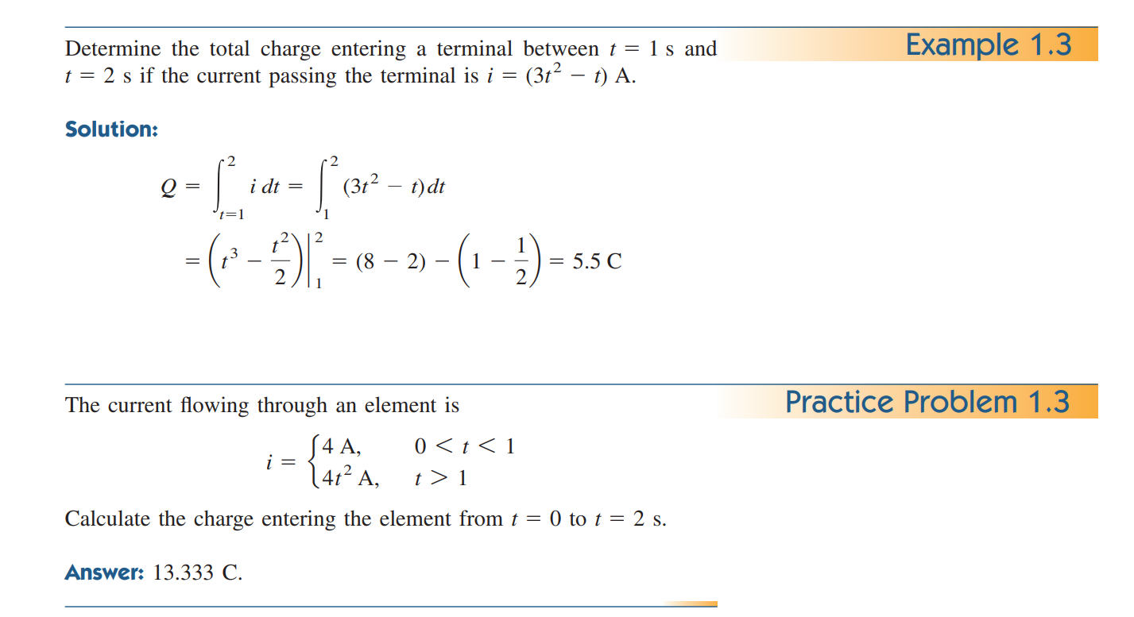

Slide 15
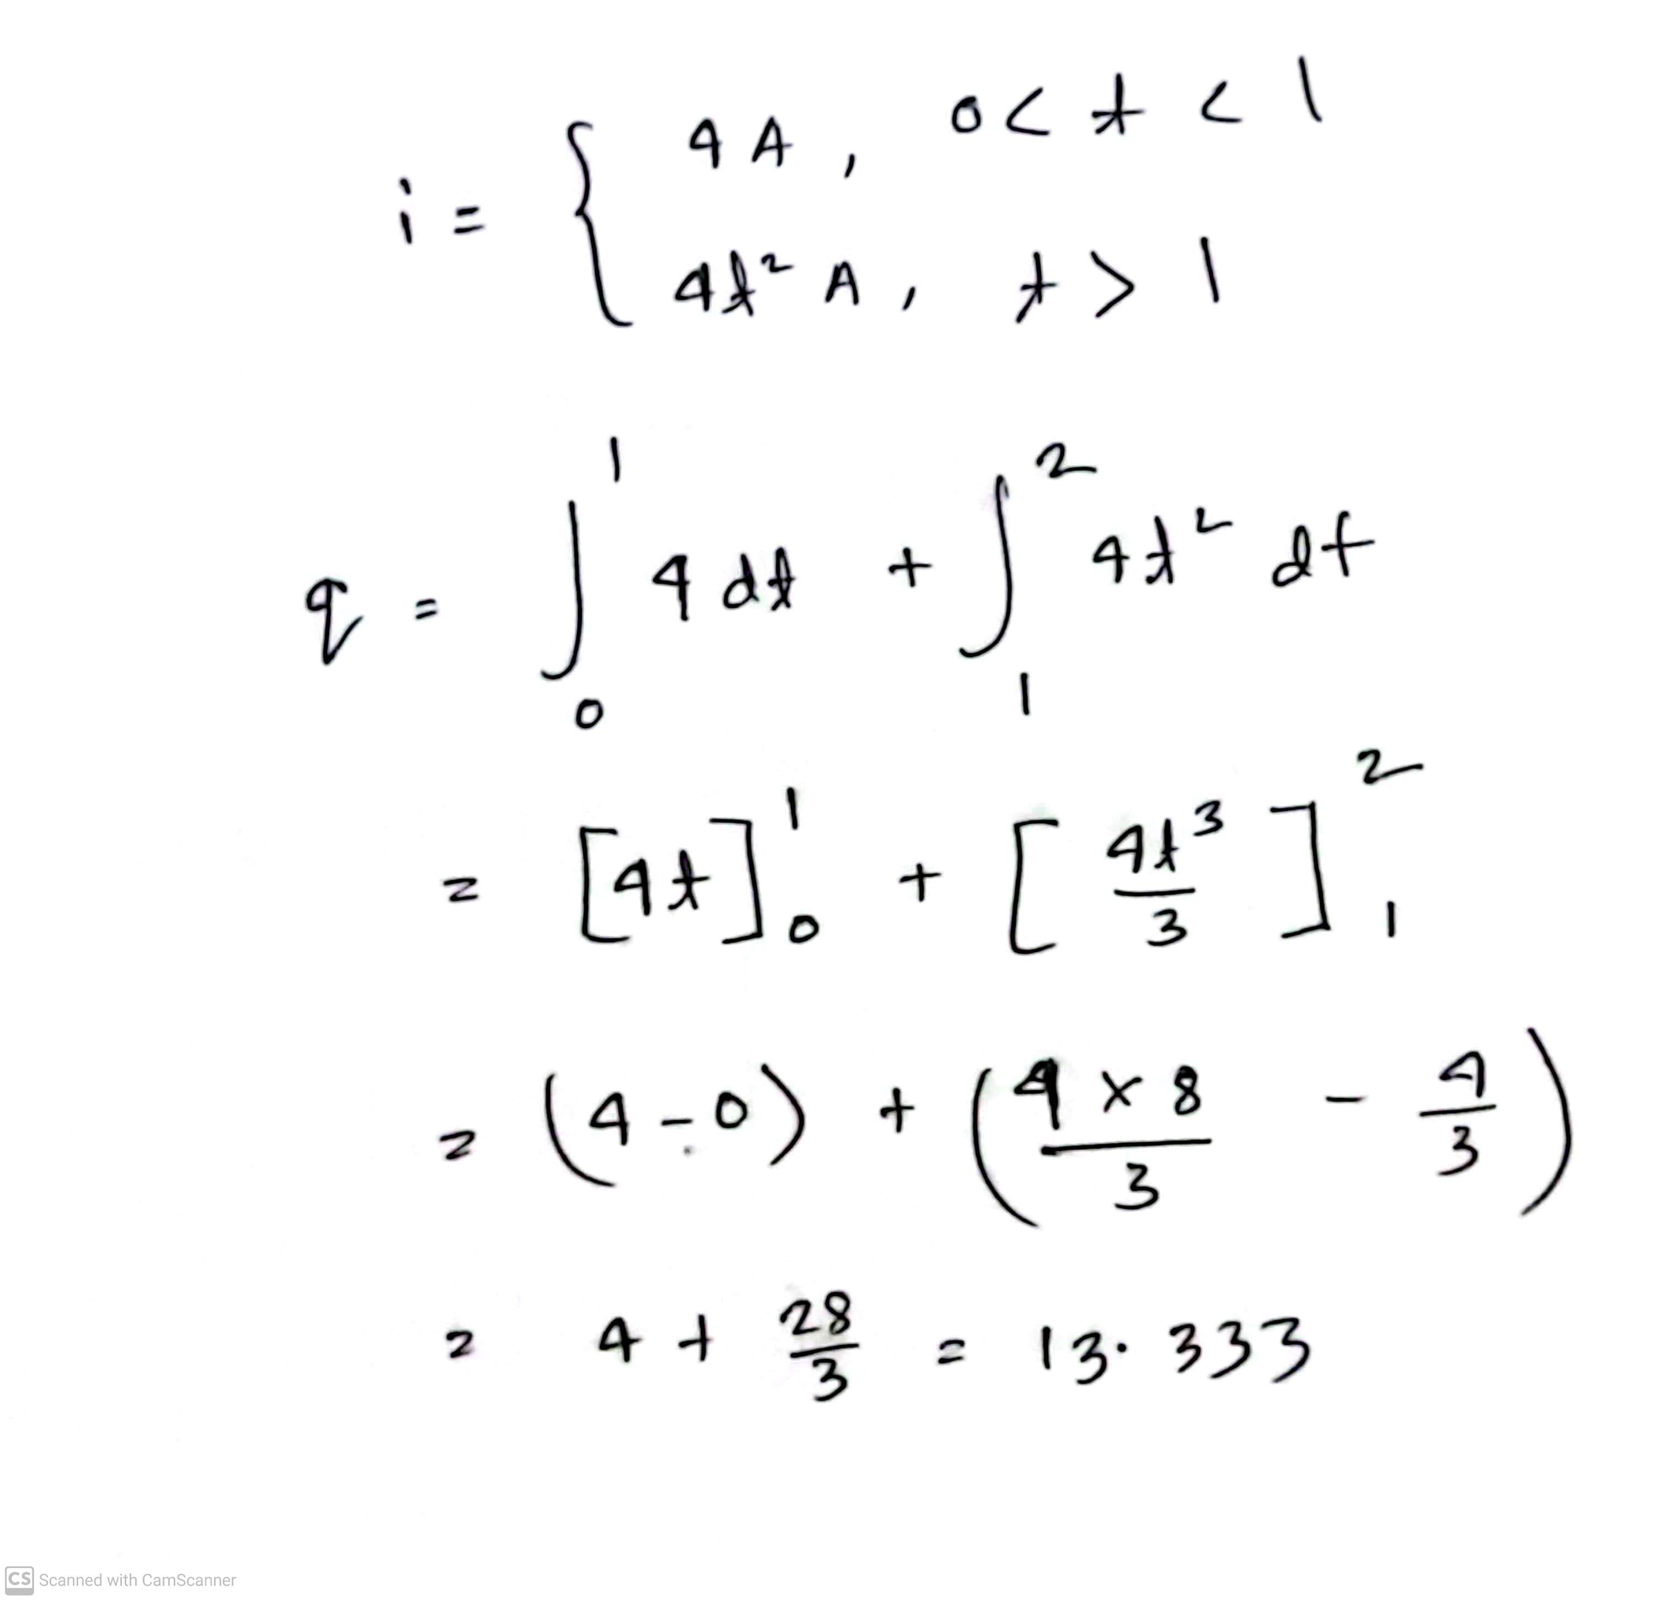
Practice problem 1.3 (Solve)

Slide 16
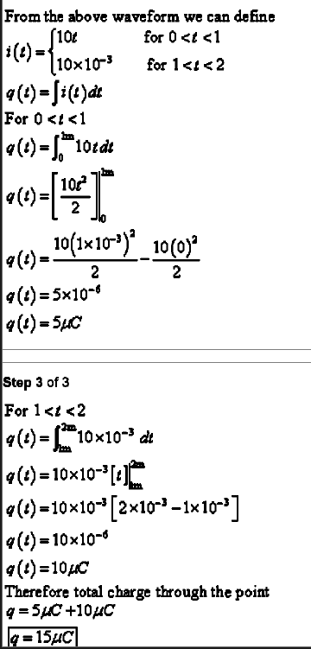
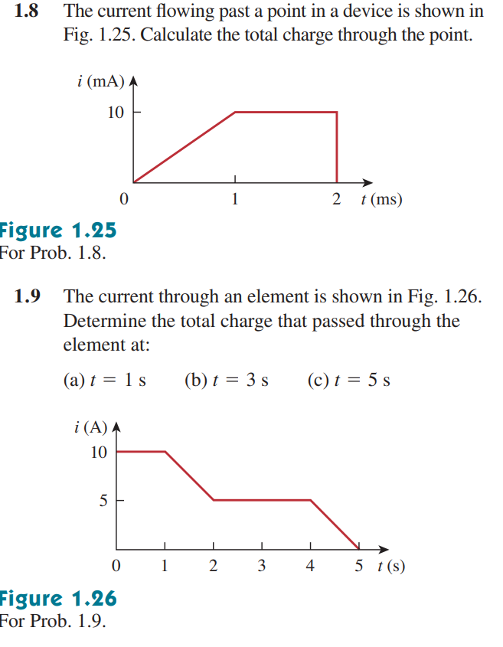
Math Problem Practice:

Slide 17
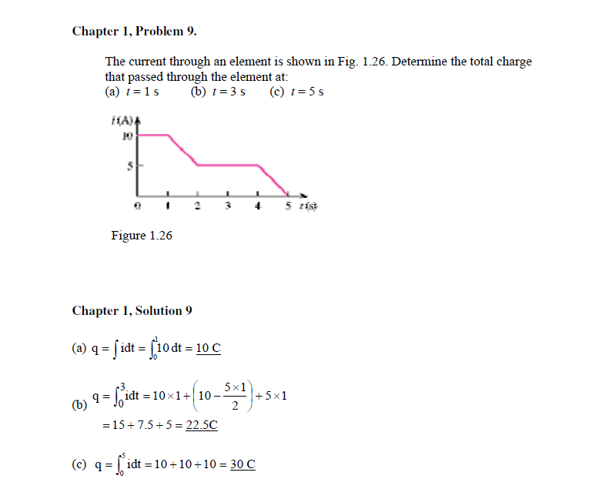
Math Problem Practice:

Slide 18

Voltage
To move the electron in a conductor in a particular direction requires some work or energy transfer.
This work is performed by an external electromotive force (emf), typically represented by the battery.
The voltage between two points a and b in an electric circuit is the energy (or work) needed to move a unit charge from a to b

Slide 19
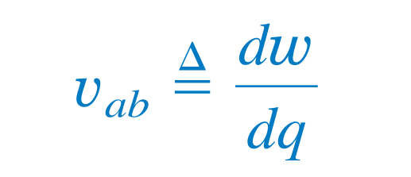
Voltage
Voltage (or potential difference) is the energy required to move a unit charge through an element, measured in volts (V).
1 V = 1 J/C

Slide 20
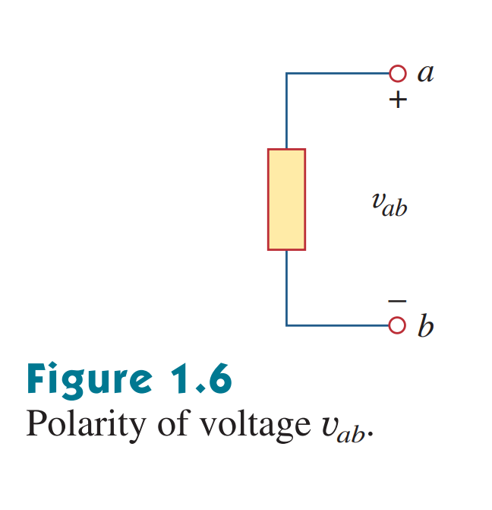
Polarity of voltage
Voltage arises due to the difference in electric potential between two points in a circuit.
The point which has a higher potential is given a ‘+’ polarity, while the point which is at a lower potential is given a ‘-’ polarity
v_{ab} = -v_{ba}

Slide 21
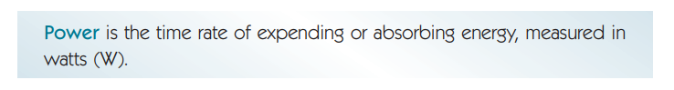
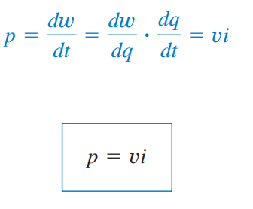
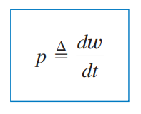
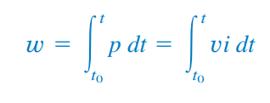
Electrical Power and Energy

Slide 22
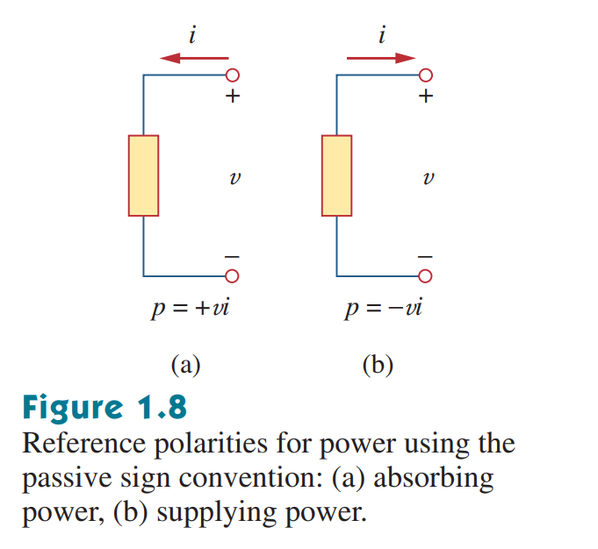
Sign Convention for Power
If current is entering through the positive terminal of a component, we give it a positive sign
A positive power indicates power absorbed by the component
If current is entering through the negative terminal of a component, we give it a negative sign
A negative power indicates power supplied by the component
In an electric circuit,
total power supplied = - total power absorbed
Notes:
Show a basic circuit

Slide 23
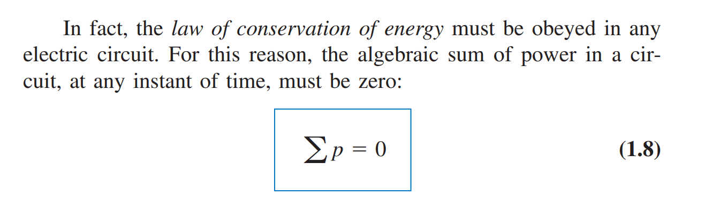
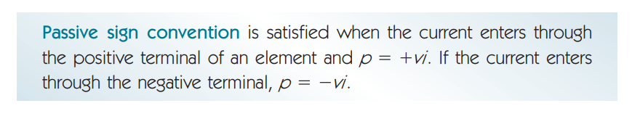
Law of Conservation of Energy in Circuits

Slide 24
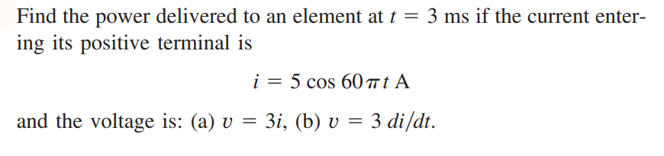
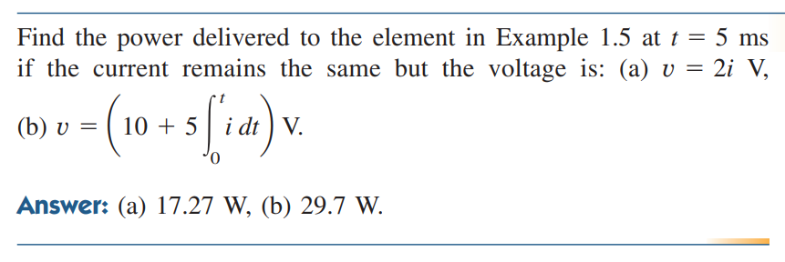
Math Problem Practice:

Slide 25
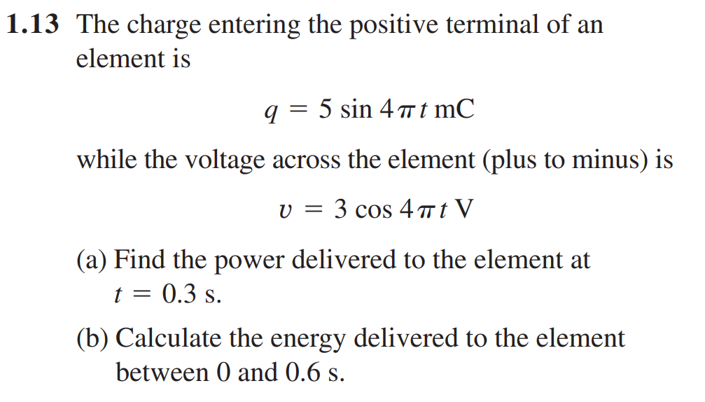

Math Problem Practice:
Ans:

Slide 26
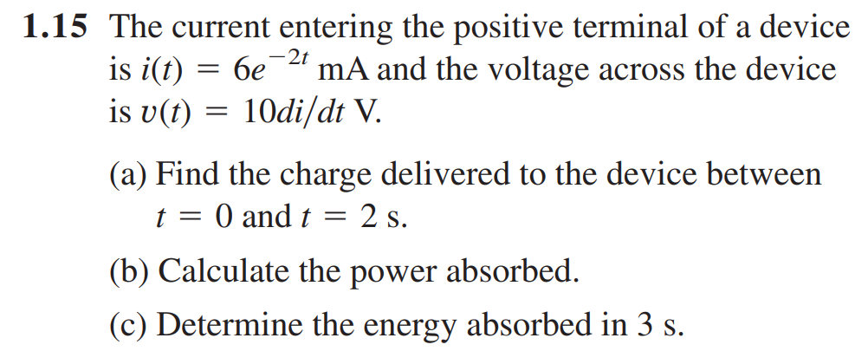
Math Problem Practice:
Ans:

Slide 27
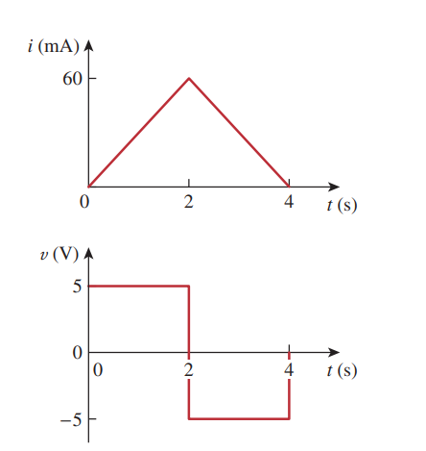
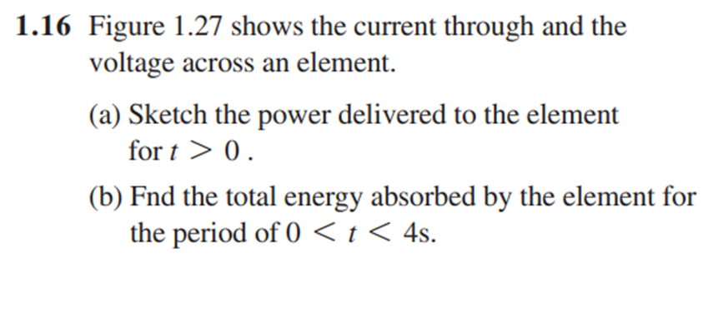
Math Problem Practice:

Slide 28
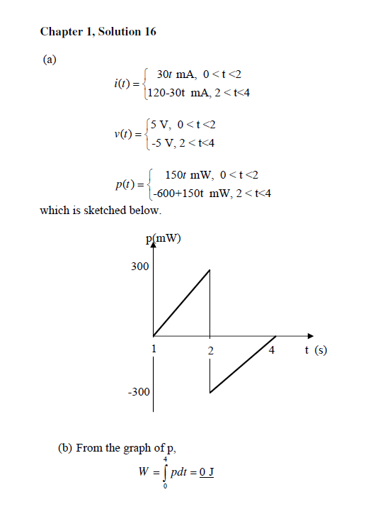

Slide 29
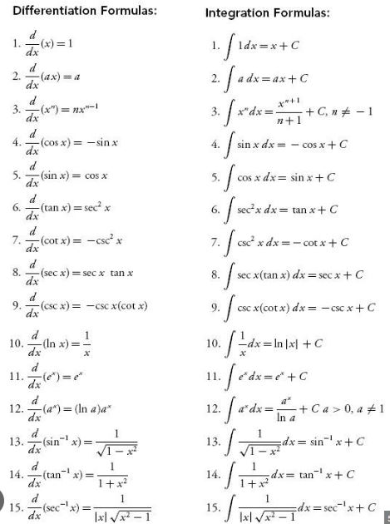

Slide 30
Thank you

